Slide 1

AIRBNB Booking Analysis
AIRBNB Booking Analysis
Presented By Shalini Soni
Presented By Shalini Soni

Slide 2
Objective
This Airbnb project aims to analyze pricing factors in the New York City market, focusing on elements like location, property type, and amenities.
By identifying pricing trends, the project will provide insights for travelers and help hosts optimize their listings.
The findings will also offer strategic recommendations for Airbnb, enhancing its competitiveness and promoting a balanced rental ecosystem that benefits both hosts and guests.

Slide 3
Project Summary
This project analyzes factors influencing Airbnb prices in New York City, focusing on patterns among variables.
The dataset was cleaned to address inconsistencies, missing values, and duplicates, ensuring reliable analysis.
Exploratory analysis revealed key factors like minimum nights, reviews, and host listing counts affecting pricing, alongside significant neighborhood variations.
Visualizations highlighted these trends, providing actionable insights for travelers and hosts.
Findings offer a foundation for future research and data-driven decision-making.

Slide 4
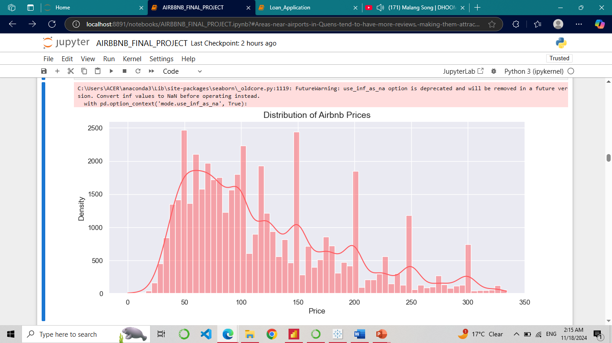
Distribution of Airbnb Bookings Price Range Using Histogram.
Insights
The range of prices extends from 20 dollars to 300 dollars, with most listings priced between 50 and 150 dollars.
Most listings are priced in the 50 to 150 dollars range, and there are fewer listings at bit lower and higher prices.
There are fewer listings above 250 dollars, as the number of listings drop significantly in this price range.

Slide 5
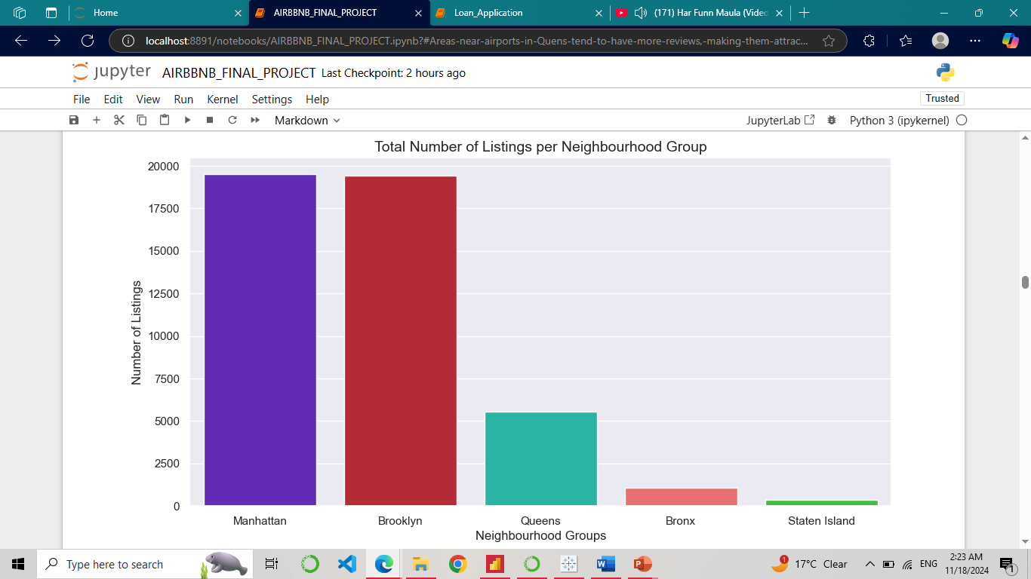
Total Listing/Property count in each neighbourhood group using bar plot.

Slide 6
Insights
Manhattan and Brooklyn have the most listings on Airbnb with over 19,000 listings.
Queens and the Bronx have fewer listings, with 5,567 and 1,070 listings.
State Island has the least number of listings with only 365.
Queens, Bronx and State Island are larger in size, they have fewer listings than Manhattan.
Therefore, Manhattan has higher demand for Airbnb rentals than other groups.
Neighbourhood Groups | Lisitng Counts
Manhattan | 19506
Brooklyn | 19415
Queens | 5567
Bronx | 1070
Staten Island | 365

Slide 7
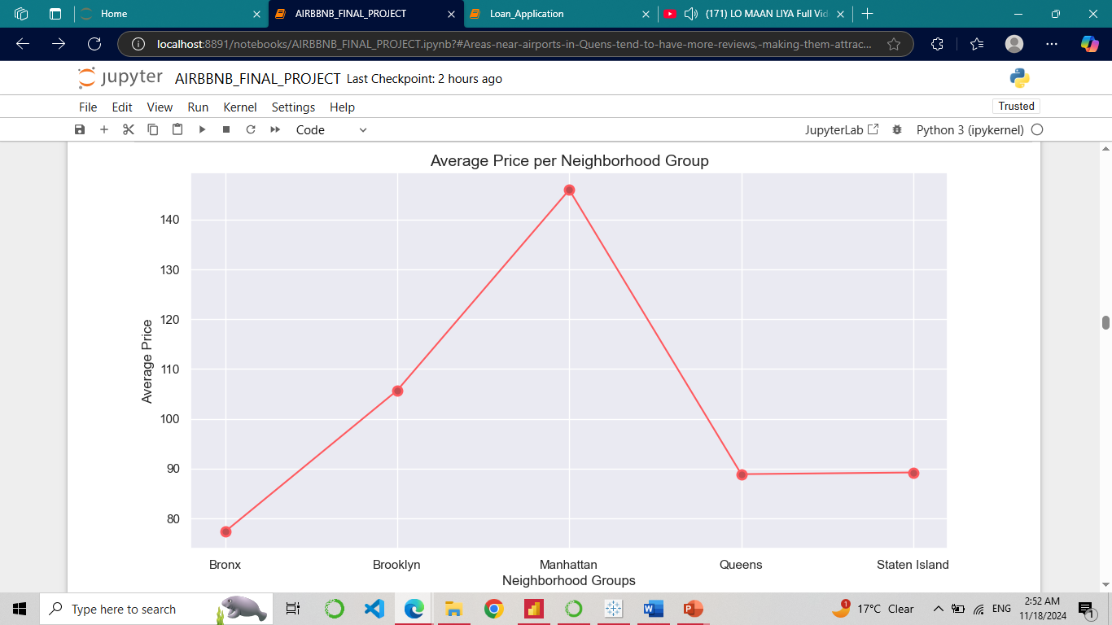
Average Price of Each Neighborgood Group using line chart.

Slide 8
Insights
Manhattan has the highest average price at 140 dollars per day while Bronx has the lowest at 74 dollars per day.
Manhattan and Brooklyn have high price variations showing the most diversity in pricing.
Queens and State Island have similar average prices, despite being in different parts of the city.
Manhattan is the most expensive due to high demand, while outer groups like Bronx and State Island are more affordable.
Neighborhood Group | Average Price
Bronx | 77.37
Brooklyn | 105.70
Manhattan | 145.95
Queens | 88.90
Staten Island | 89.24

Slide 9
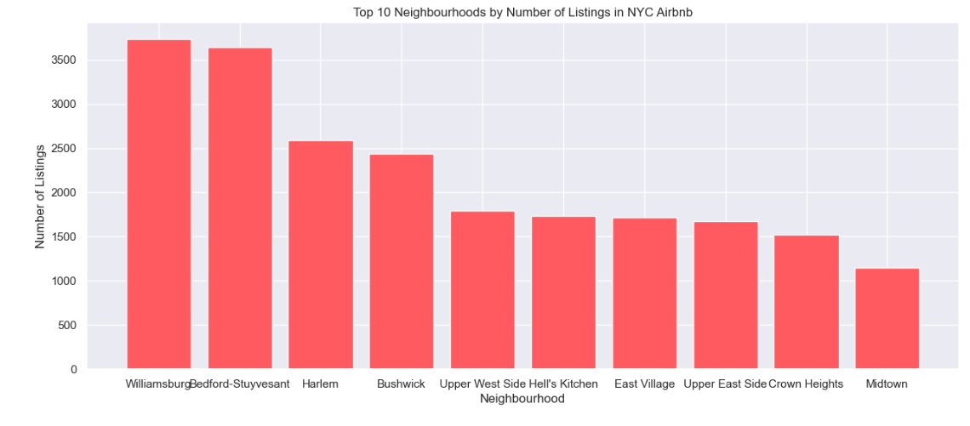
Top Neighborhood by Listings/Property using Bar plot.

Slide 10
Insights
The neighborhoods with the most Airbnb listings are Bedford-Stuyvesant (1653), Williamsburg (1526), Harlem (1216), Bushwick (1122), and Hell's Kitchen (847)
Popular areas like Upper East Side (758), Upper West Side (739), and East Village (722) also have significant listings.
Emerging neighborhoods such as Crown Heights (653) and Greenpoint (536) are showing increasing interest.
The top neighborhoods are mostly in Brooklyn and Manhattan, which are the most densely populated boroughs in NYC with high housing demand.
The number of listings reflects popularity but doesn't necessarily indicate full demand, as factors like cost of living and housing availability also play a role.
Top Neighbourhoods | Listing Counts
Williamsburg | 3732
Bedford-Stuyvesant | 3638
Harlem | 2585
Bushwick | 2438
Upper West Side | 1788
Hell's Kitchen | 1731
East Village | 1714
Upper East Side | 1670
Crown Heights | 1519
Midtown | 1144

Slide 11
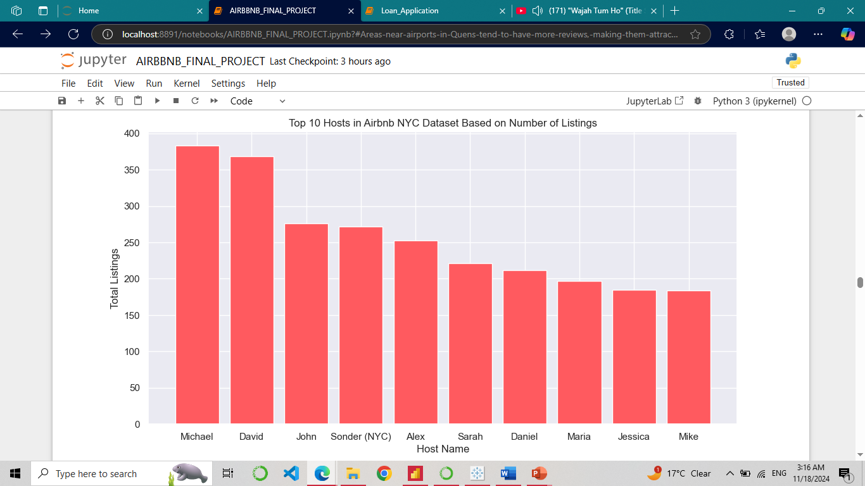
Top hosts with more Listing/Property using bar chart.

Slide 12
Host Name | Total Listings
Michael | 383
David | 368
John | 276
Sonder (NYC) | 272
Alex | 253
Sarah | 221
Daniel | 212
Maria | 197
Jessica | 185
Mike | 184
Insights
The top three hosts with the most listings are Michael (184), David (172), and John (135).
Michael and David have far more listings than most other hosts.
There's a big range in how many listings each host has—for example, Michael has 184, while another host, Mike, has only 94.
A few hosts control many listings, making the Airbnb market competitive.
Some hosts, like Sonder (NYC), have many listings, possibly because they have more resources or better branding.

Slide 13
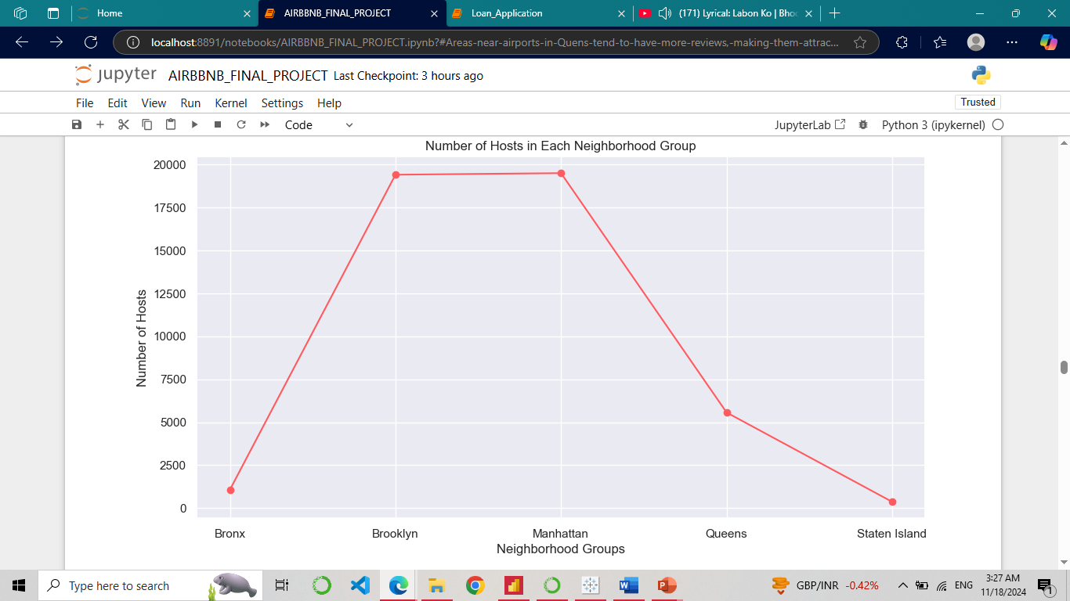
Number Of Active Hosts Per Location Using Line Chart.
Insights
Manhattan has the largest number of hosts with 8588,Brooklyn has the second largest number of hosts with 8656.
After that Queens with 2579 and the Bronx with 522 while Staten Island has the fewest with 185.
Brooklyn and Manhattan have the largest number of hosts, with more than double the number of hosts in Queens and more than 18 times the number of hosts in the Bronx.

Slide 14
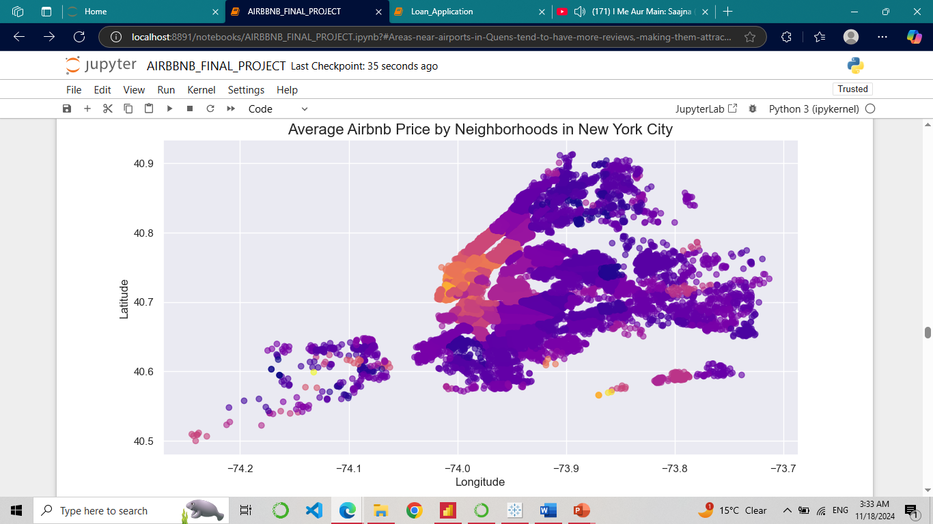
Average Minimum Price In Neighborhoods using Scatter and Bar chart.

Slide 15
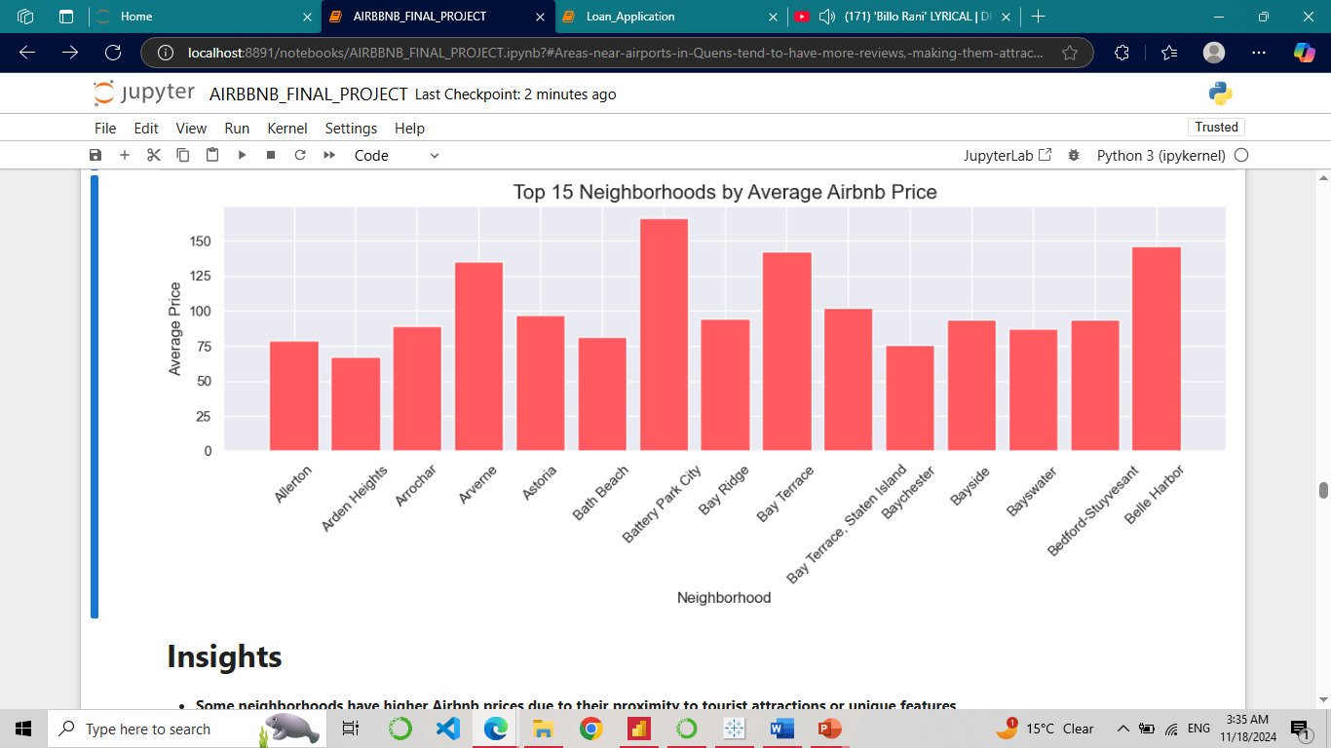
Insights
Some neighborhoods have higher Airbnb prices due to their proximity to tourist attractions or unique features.
There's a clear price gap, with luxury areas costing more than budget-friendly ones.
Scenic or culturally rich areas also have higher prices.
Seasonal demand can affect prices, with hosts adjusting rates accordingly.
Overall, location and timing are key factors in determining Airbnb prices.

Slide 16
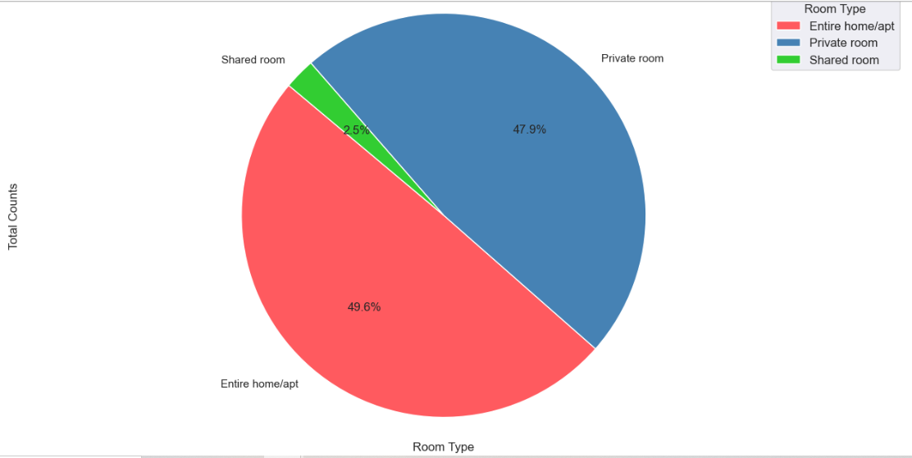
Total Counts Of Each Room Type.
Insights
Most people prefer renting entire homes or apartments, with 22,789 listings, followed by private rooms at 21,996.
Shared rooms are much less common, with only 1,138 listings.
This shows that most guests like having their own space, while only a few choose shared rooms.
There’s also a small group of budget travelers who go for shared rooms.

Slide 17
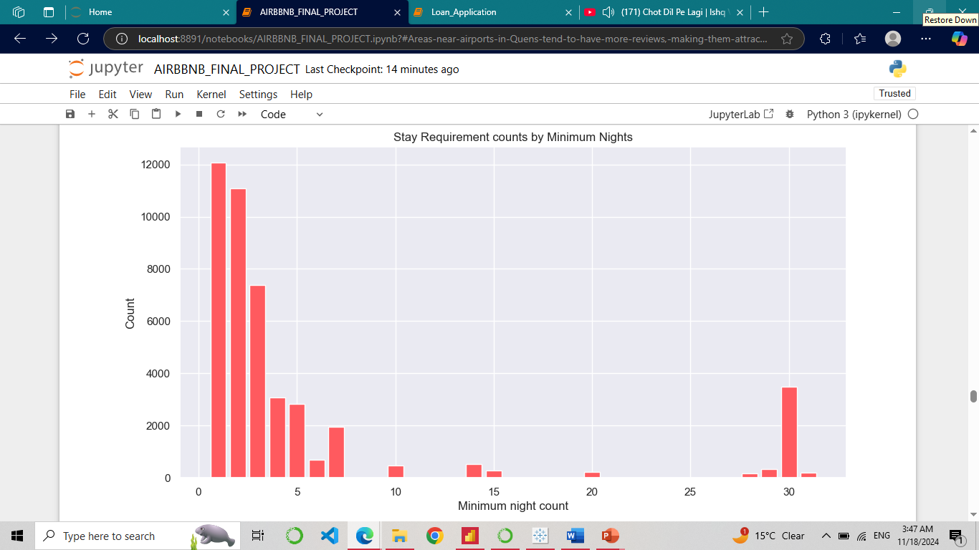
Stay Requirement counts by Minimum Nights using Bar chart.

Slide 18
Insights
The majority of listings on Airbnb have a minimum stay requirement of 1 or 2 nights, with 12067 and 11080 listings, respectively.
The number of listings with a minimum stay requirement decreases as the length of stay increases, with 7375 listings requiring a minimum stay of 3 nights, and so on.
There are relatively few listings with a minimum stay requirement of 30 nights or more, with 3493 and 189 listings, respectively.
Minimum Nights | Counts
1 | 12067
2 | 11080
3 | 7375
30 | 3493
4 | 3066
5 | 2821
7 | 1951
6 | 679
14 | 539
10 | 462
29 | 327
15 | 272
20 | 215
31 | 189
28 | 173

Slide 19
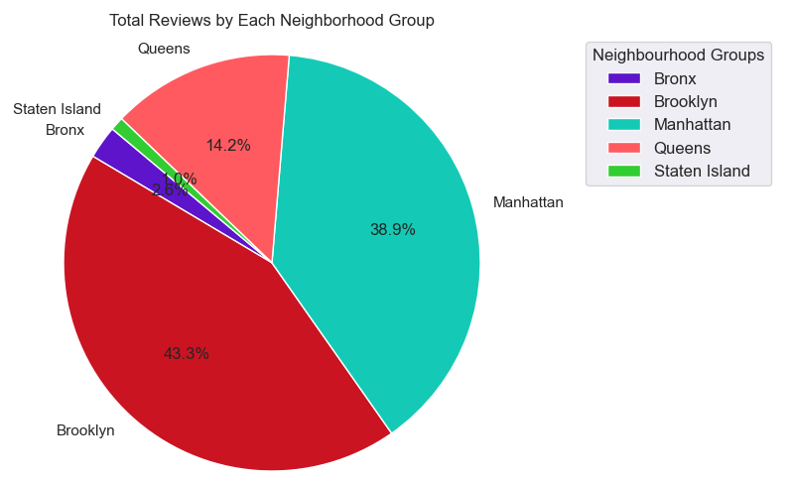
Total Reviews by Each Neighborhood Group using Pie Chart.

Slide 20
Insights
Brooklyn has the largest share of total reviews on Airbnb, with 43.3%, followed by Manhattan with 38.9%.
Queens has the third largest share of total reviews, with 14.2%, followed by the Bronx with 2.6% and Staten Island with 1.0%.
The data suggests that Airbnb is more popular in Brooklyn and Manhattan compared to the other neighborhood groups.
Brooklyn has more reviews than Manhattan, even though it has fewer listings.
This could mean guests in Brooklyn are more likely to leave reviews or that the listings are more popular.
Neighbourhood Group | Number of Reviews
Bronx | 28185
Brooklyn | 475936
Manhattan | 428143
Queens | 155719
Staten Island | 11536

Slide 21
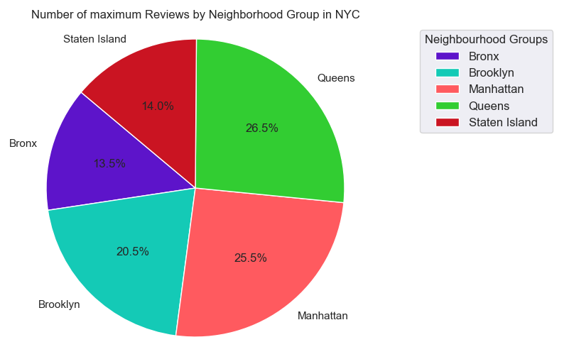
Number of Maximum Reviews by Each Neighborhood Group using Pie Chart.

Slide 22
Insights
Queens and Manhattan seem to be the most popular neighborhoods for reviewing, as they have both high number of maximum reviews.
Queens and Manhattan seem to be the most popular neighborhoods for reviewing, as they have both high number of maximum reviews.
Manhattan and Brooklyn also have a high percentage of reviews, at 25.5% & 20.5%.
This indicates that Manhattan is a popular destination for tourists or visitors as well.**
Neighborhood Group | Number of reviews
Bronx | 321
Brooklyn | 488
Manhattan | 607
Queens | 629
Staten Island | 333

Slide 23
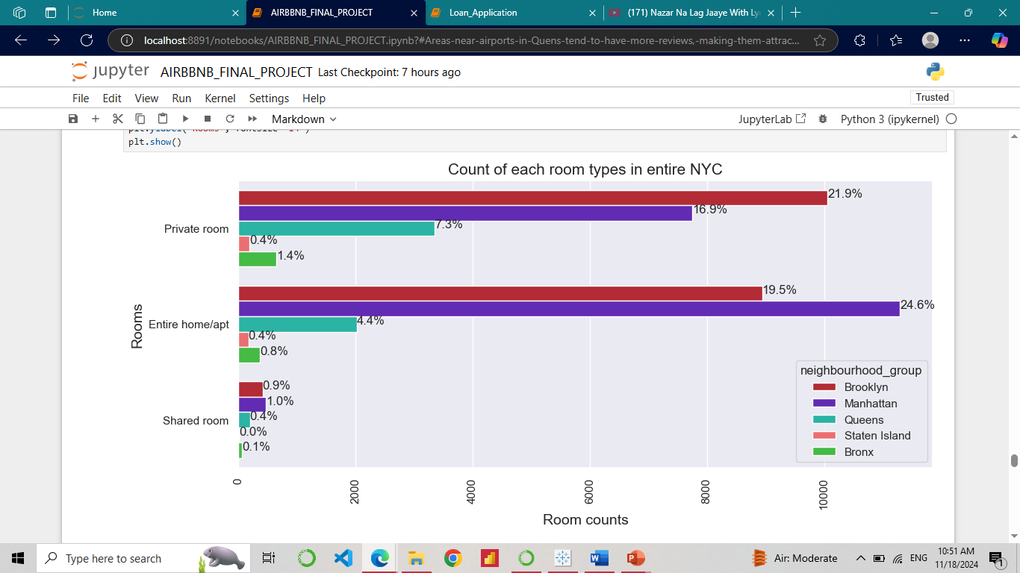
Count Of Each Room Types In Entire NYC Using Multiple Bar Plot.

Slide 24
Insights
Manhattan has more listed properties with Entire home/apt around 24.6% of total listed properties followed by Brooklyn with around 19.5%.
Private rooms are more in Brooklyn as in 21.9% of the total listed properties followed by Manhattan with 16.9% of them.
While 7.3% of private rooms are from Queens.
Very few of the total listed have shared rooms listed on Airbnb where there's negligible or almost very rare shared rooms in Staten Island and Bronx.
We can infer that Brooklyn, Queens, Bronx has more private room types while Manhattan which has the highest no of listings in entire NYC has more Entire home/apt room types.
Room Type | Entire home/apt | Private room | Shared room
Neighbourhood Group
Bronx | 363 | 648 | 59
Brooklyn | 8942 | 10062 | 411
Manhattan | 11294 | 7747 | 465
Queens | 2022 | 3351 | 194
Staten Island | 168 | 188 | 9

Slide 25
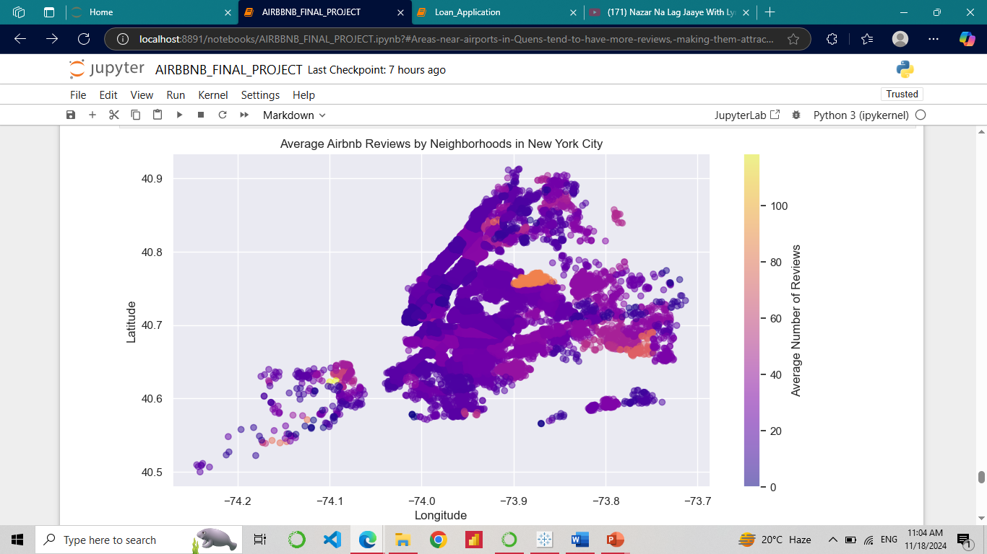
Find Best Location Listing/Property Location For Travelers and Hosts.

Slide 26
Insights
Neighborhoods near the airport in Queens have higher average reviews, likely due to their convenience for travelers passing through.
Proximity to the airport, along with possible high-quality listings and nearby attractions, makes these areas appealing for short stays.
Index | Neighbourhood | Average Reviews
0 | Allerton | 42.878049
1 | Arden Heights | 7.750000
2 | Arrochar | 15.300000
3 | Arverne | 30.097222
4 | Astoria | 21.696731
... | ... | ...
214 | Willowbrook | 9.000000
215 | Windsor Terrace | 28.786667
216 | Woodhaven | 31.727273
217 | Woodlawn | 44.000000
218 | Woodside | 21.675325

Slide 27
THANK YOU

